Slide 1
A Brief Introduction to Linear Regression Model with Panel Data
A brief overview of linear regression model assumptions.
A brief overview of cross-section and panel data.
Test of hypothesis for model specification test.
Brief overview of heterogeneity and endogeneity issues with panel data.
Between groups and between times model.
One way and Two way fixed and random effect models overview.
Pinto Bhusan Datta, M.Sc. (Statistics), M.Sc. (Operation Research and Business Analytics (Pursuing))
Working Student, HVB.

Slide 2
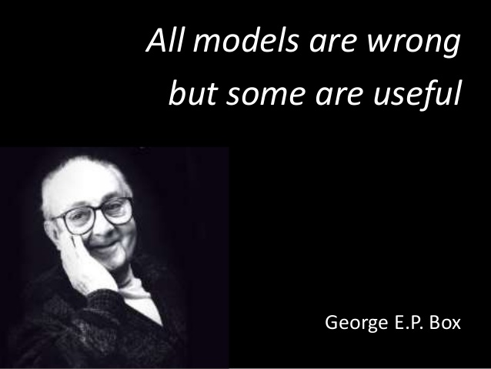
Image source: “All models are wrong, but some are useful”. George E. P. Box – AdMoRe ITN (upc.edu)
Details:All models are wrong - Wikipedia
1

Slide 3
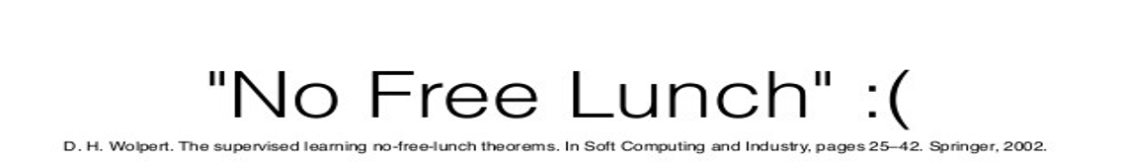


2

Slide 4
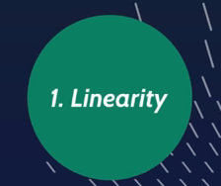
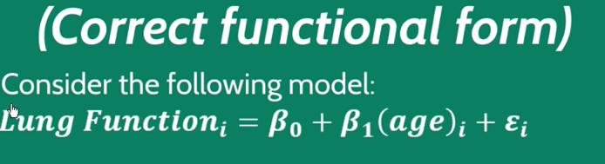
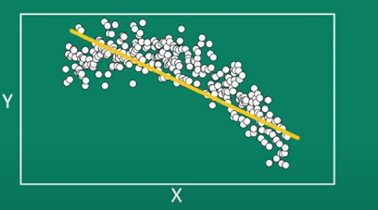
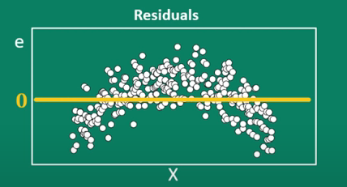
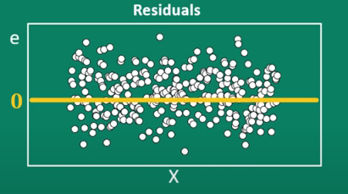
Linear Regression Assumptions
Source: Regression assumptions explained! - YouTube
3
Notes:
The regression model is linear in parameter not linearity in variables

Slide 5
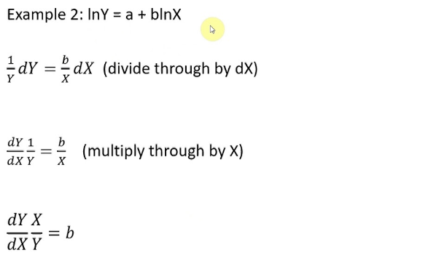
Other forms
Linear in parameter
Elasticity from Linear Regression Model
Non-linear in parameter
4

Slide 6

What's the issue
Due to wrong functional form there is a great chance that both the coefficients and standard error are biased
Detection Methods
Residual plots
Likelihood Ratio (LR) Test
Treatments
Get the correct specification
Correct (Trial and error)
Machine Learning methods are more prudent here!!!
5

Slide 7
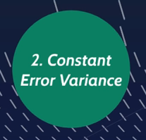
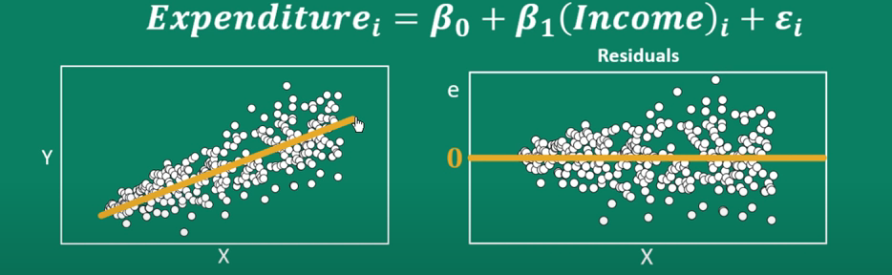
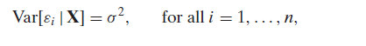
What's the issue
Due to heteroscedasticity, standard error will be biased
6

Slide 8
Detection Methods
Residual plots
Goldfeldt-Quant test
Breusch-Pagan test
Treatments
Whits standard errors
Weighted least squares
Log transformation and many more
7

Slide 9
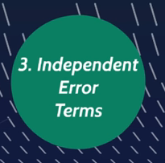
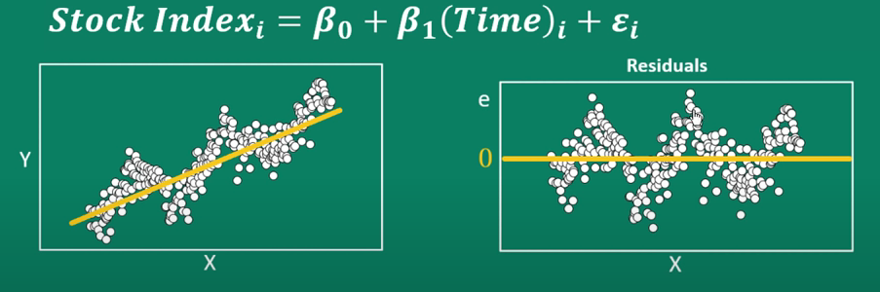

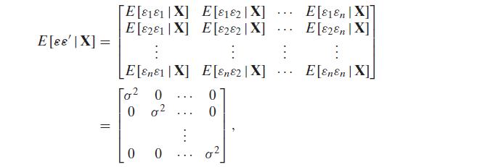
Homoscedasticity and No-Autocorrelation
8

Slide 10
What's the issue
Due to autocorrelation, standard error will be biased as well as high prediction bias.
Detection Methods
Residual plots
Durbin-Watson test
Breusch-Godfrey test
Treatments
Searching omitted variables
Generalized difference equations
Advance modelling techniques
Univariate: ARIMA, ARIMAx, SARIMA, SARIMAx, ARCH , GARCH etc.
Multivariate: like VAR, machine learning (RNN, LSTM, GRU etc.)
9

Slide 11
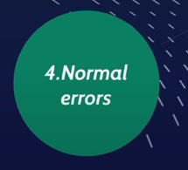
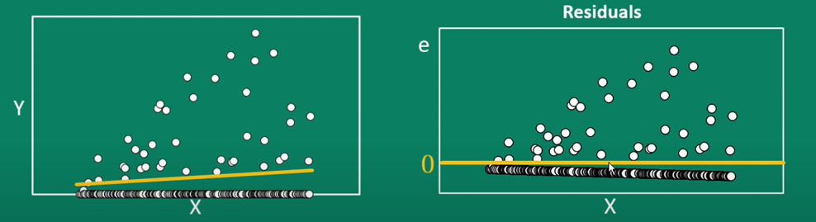
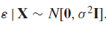
What's the issue
Due to normality violation, standard error will be biased
10

Slide 12
Detection Methods
Histogram or Q-Q plot
Shapirio-wilk test
Kolmogrov-Smirnob test
Anderson-Darling test
Treatments
Take log transformation or other variables transformations
Advance modelling techniques non-parametric methods: Stochastic Frontier.
12

Slide 13


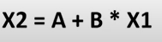
What's the issue
Due to multicolinearity, coefficients and standard error will be biased of the effected variables
Detection Methods
Scatter plot Matrix or heatmap
Variance inflation factor (VIF)
Treatments
Delete strong correlated variables except one
13
Notes:
There is no perfect multicolinearity

Slide 14

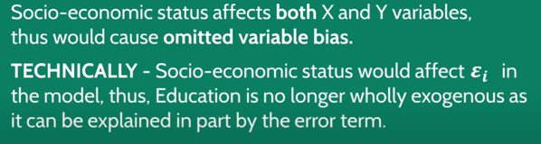

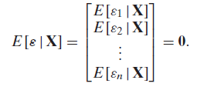
14

Slide 15
What's the issue
Due to endogeneity problem model can use for prediction but not causation
Detection Methods
Model speciation test
Test of hypothesis
Treatments
Using Instrumental variables
15

Slide 16
Other assumptions:
Full-Rank:
The number of parameters must be less than number of observations.
Data Generation:
X values fixed in repeated samples i.e. non-stochastic.
The explanatory variable in the given sample must not be the same
i.e Var(X) must be finite positive value.
Zero covariance between error and explanatory variables.
16

Slide 17
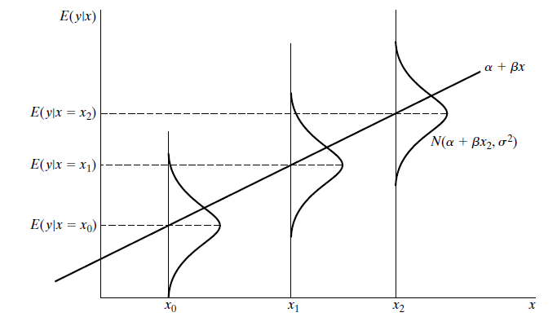
The Normal Linear Regression Model
17

Slide 18
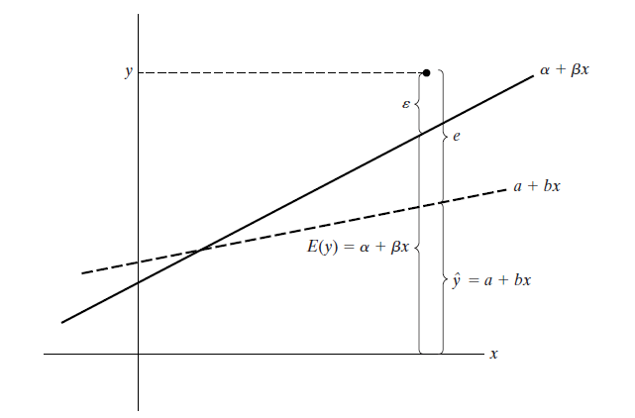
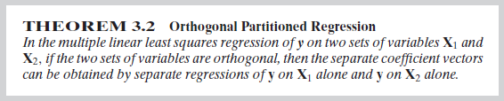
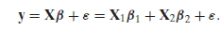
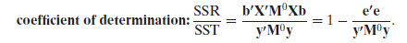
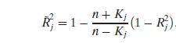
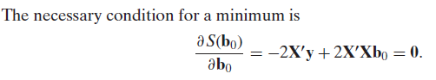
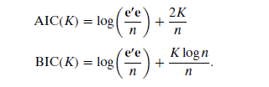
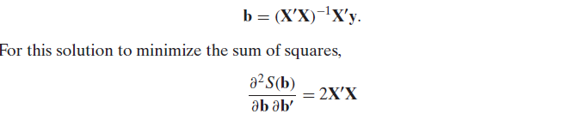
Least Square Regression
18

Slide 19
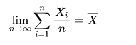
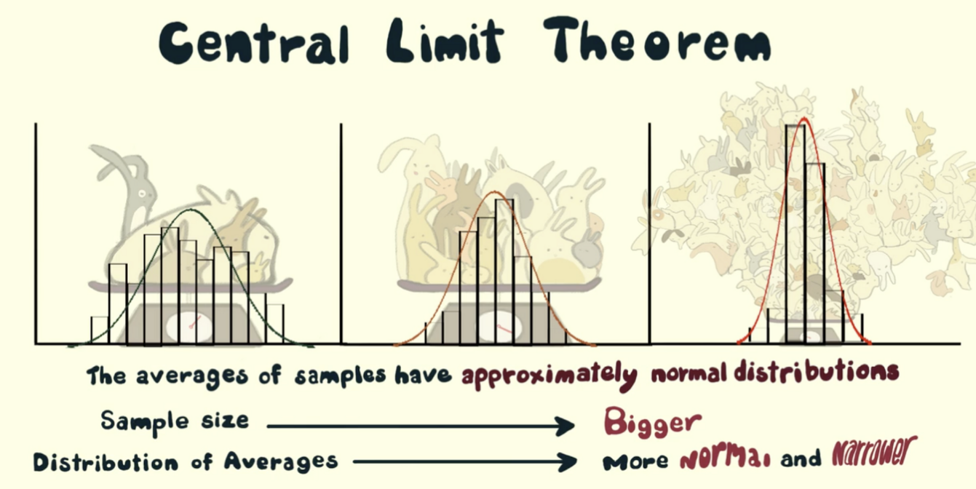
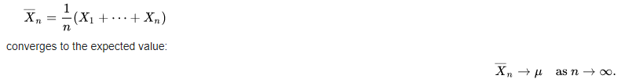
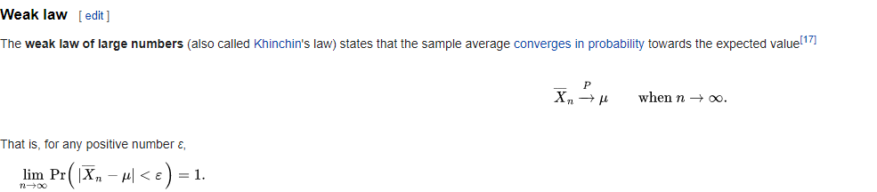
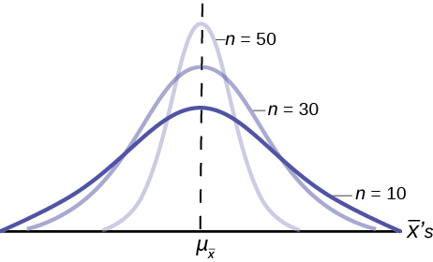
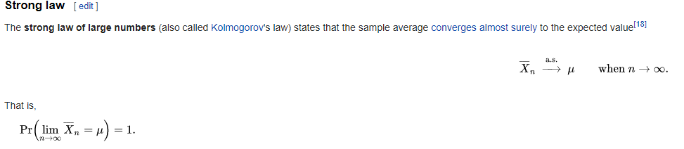
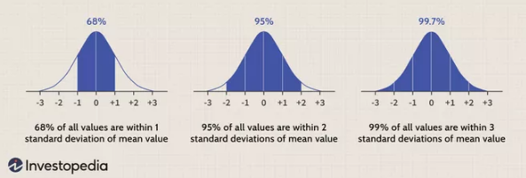
Law of large numbers and Central limit Theorem
19

Slide 20
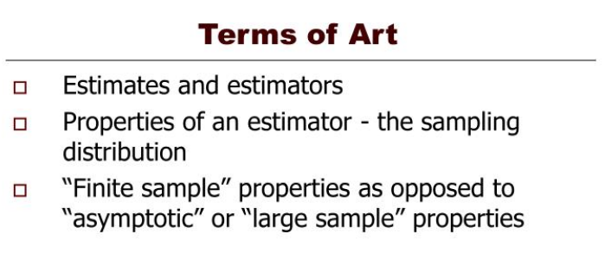
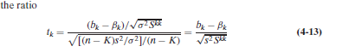
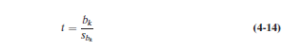
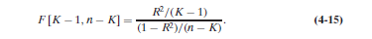
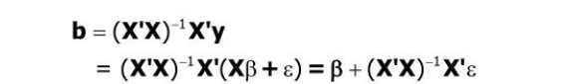
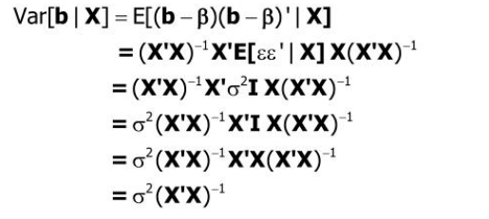
Finite sample properties of Least square estimator
Testing a Hypothesis about coefficient and Regression
Ordinary Least squares estimator and its variance
20

Slide 21
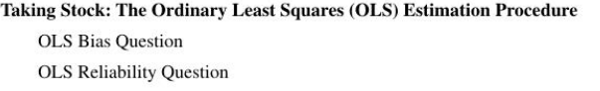
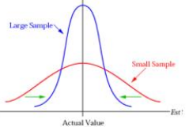
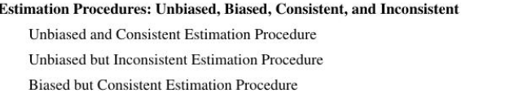
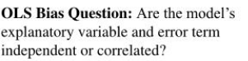
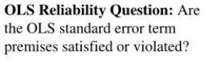
Large sample properties and instrumental variables
Independent
Correlated
OLS estimation procedure for the value of the Coefficient is Unbiased
Use alternative approach which may be biased but consistent.
If “Violated” then use alternative approach like GLS.
Satisfied
The OLS estimation procedure is BLUE and the coefficient standard error may be trusted.
21

Slide 22
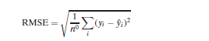
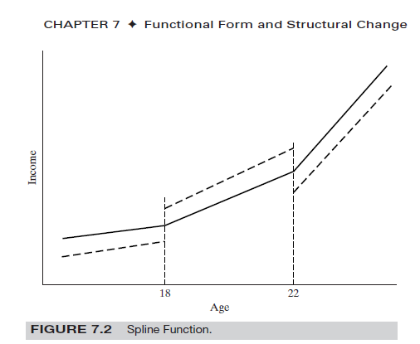
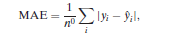



Others measures for assessing prediction accuracy
22

Slide 23





Model Specification Tests
Others Specification Tests
Lagrange Multiplier (LM) Test
Wald Test Tests
Classical Model Selection
Parametric Vision.
Assuming a true data-generating process.
Evaluation based on fit.
Ignoring Model uncertainty.
Source: Regression Specification - YouTube
23

Slide 24



Cross-Sectional Data
Panel Data
Source: [Lesson 1] The Charm of DSLR Cameras (canon-asia.com)
Datatabel: Introduction to the Fundamentals of Panel Data - Aptech
24

Slide 25


Balanced Panel Data
Unbalanced Panel Data
25

Slide 26


Slide 27





NONSPHERICAL DISTURBANCES — THE GENERALIZED REGRESSION MODEL (GLS)
26
10 Non-Spherical Errors | Practical Data Analysis for Political Scientists (bkenkel.com)

Slide 28

One Way Fixed Effect Model
27

Slide 29



Fixed Effect Model (Within Transformation)
28

Slide 30




Two Way Fixed Effect Model (Within Transformation + Dummy Technique)
First deference estimator
What's the difference between dummies and within transformation
A dynamic model
29

Slide 31


One Way Random Effect Model
Two Way Random Effect Model
Image source: Introduction to the Fundamentals of Panel Data - Aptech
30

Slide 32

Estimation methods for One Way and Two Way random effect model.
Advance Methods (Hybrid Method)
Hausman-Taylor Estimation
Amemiya-MaCurdy Estimation
Parks Method (Autoregressive Model)
Da Silva Method (Variance-Component Moving Average Model)
Fuller and Battese Method
Wansbeek and Kapteyn Method
Wallace and Hussain Method
Nerlove Method
Panel Data Poolability Test
Specification Tests
Null hypothesis: Poolability assumes homogeneous slope coefficients i.e. There is no fixed effect.
F Test
Breusch-Pagan (BP) test for one-way random effects
Breusch-Pagan (BP) test for two-way random effects
F Test
LR Test
31

Slide 33





Panel Data Cross-Sectional Dependence Test
Getting Started: PANEL Procedure
Null hypothesis: zero cross-sectional error correlations.
Unit Root Test
Test all time series analysis related tests
Lagrange Multiplier (LM) Tests for Cross-Sectional and Time Effects.
Tests for Serial Correlation and Cross-Sectional Effects
Wooldridge Test for the Presence of Unobserved Effects
Bera, Sosa Escudero, and Yoon Modified Rao’s Score Test in the
Presence of Local Misspecification.
LM Test for First-Order Correlation under Fixed Effects
Baltagi and Li Joint LM Test for Serial Correlation and Random Cross-Sectional Effects
32

Slide 34







33

Slide 35





34

Slide 36

CRISP-DM
35

Slide 37
Limitations
There is no details about mentioned algorithms.
Little amount of data visualizations.
Little amount of mathematical derivations.
36

Slide 38
References
Greene, William H. Econometric analysis. Pearson Education India, 2003.
Wooldridge, Jeffrey M. Econometric analysis of cross section and panel data. MIT press, 2010.
Others mentioned websites and lecture notes from my current study.

Slide 39


